Slide 1


Slide 2
Overview Of Amazon Sales Data
The data consists of sales record of three cities/branch in Myanmar which are Naypyitaw, Yangon, Mandalay which took place in first quarter of year 2019 . The data consists of 1000 rows and 17 columns.
Objective of Project
The major aim of this project is to gain insight into the sales data of Amazon to understand the different factors that affect sales of the different branches

Slide 3
Preview of Amazon Sales Data
Column | Description | Data Type
Invoice Id | Invoice of the sales made | Varchar(30)
Branch | Branch at which sales were made | Varchar(5)
City | The location of the branch | Varchar(30)
Customer Type | The type of the customer | Varchar(30)
Gender | Gender of the customer making purchase | Varchar(10)
Product Line | Product line of the product sold | Varchar(100)
Unit Price | The price of each product | Decimal(10,2)
Quantity | The amount of the product sold | Int
VAT | The amount of tax on the purchase | Float
Total | The total cost of the purchase | Decimal(10,2)
Date | The date on which the purchase was made | Date
Time | The time at which the purchase was made | Time
Payment Method | The total amount paid | Varchar(15)
Cogs | Cost Of Goods sold | Decimal(10,2)
Gross Margin Percentage | Gross margin percentage | Float
Gross Income | Gross Income | Decimal(10,2)
Rating | Rating | Decimal(3,1)

Slide 4

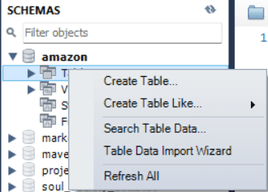
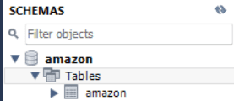

Data Wrangling
Step [1]: Created a database named Amazon in MySQL.
Step [2]: Importing data in the form of a demo table named Amazon using table data import wizard.

Slide 5
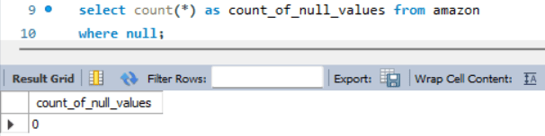
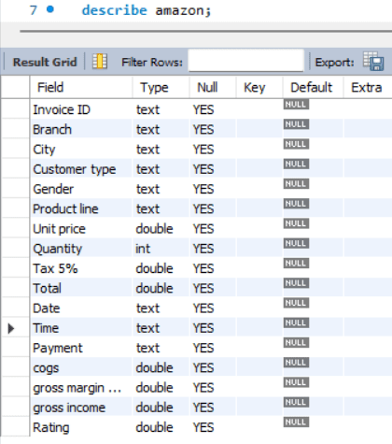
Step [3]: Checking null values and datatypes of columns of demo amazon table.
Note: as observe the datatype are incorrect and column names contain space which is syntactically incorrect, also table has no null values. This correction is done in EDA.

Slide 6
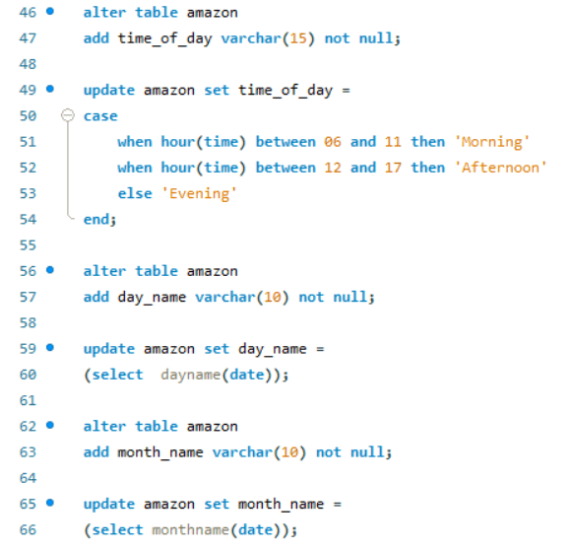
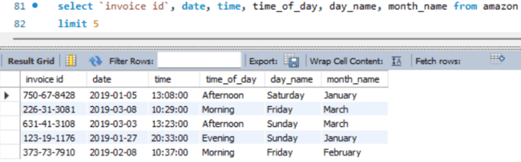
Feature Engineering
In this step we are creating new columns named timeofday, dayname, monthname by extracting values from date and time column. This will help us to analyse and answer sales based on time-of-day (Morning, Afternoon, Evening), day-of-week (Sunday to Saturday) and month (Jan-March).

Slide 7
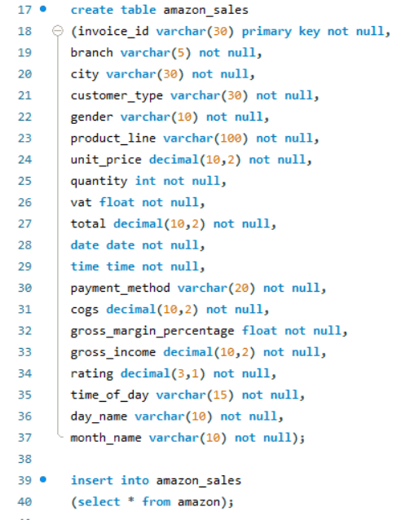
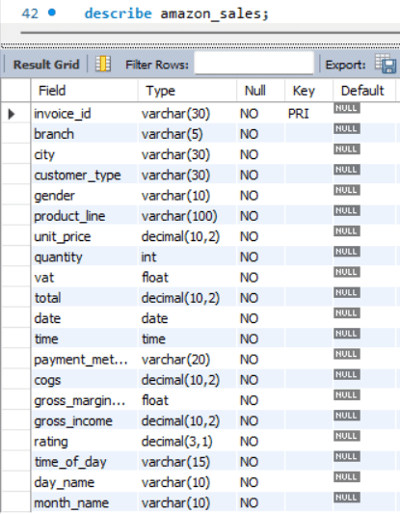
Exploratory Data Analysis
Step [1]: Creating new table named Amazon Sales by adding correct column names, datatypes, constraints while copying values from demo table Amazon.

Slide 8
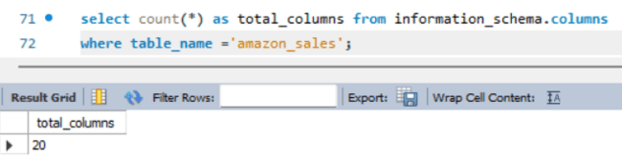
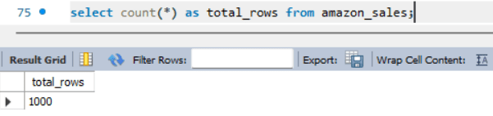
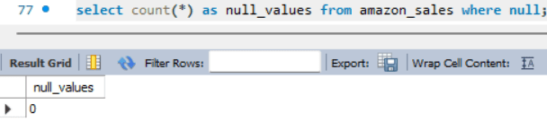
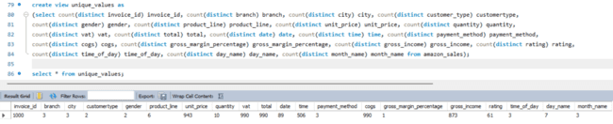
Step [2]: Checking size of table, count of null values, unique values in columns.

Slide 9







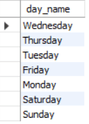
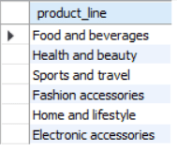
Step [3]: Checking the unique values in each categorical column. There are 10 categorical columns [invoice_id, branch, city, customer_type, gender, product_line, payment_method, time_of_day, day_name, month_name]

Slide 10
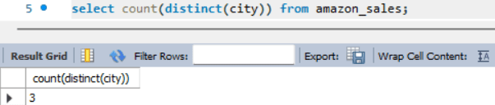
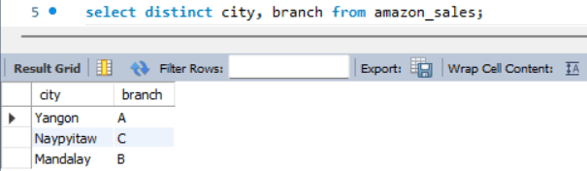
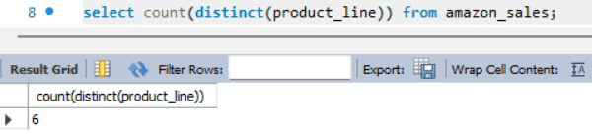
Answering Business Questions
Q.1] What is the count of distinct cities in the dataset?
Q.2] For each branch, what is corresponding city?
Q.3] What is the count of distinct product lines in the dataset?

Slide 11
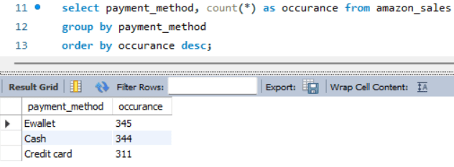
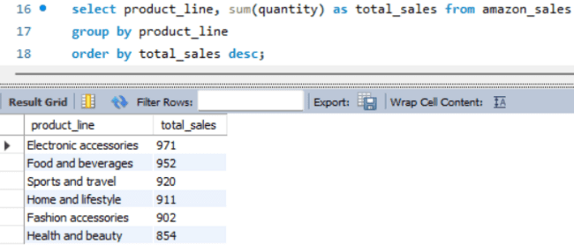
Q.4] Which payment method occurs most frequently?
Q.5] Which product line has the highest sales?

Slide 12
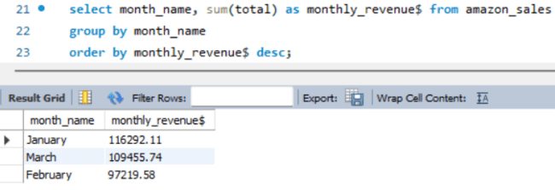
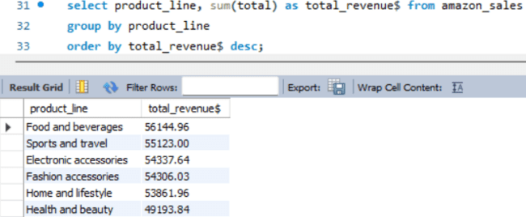
Q.6] How much revenue is generated each month?
Q.7] Which product line generated highest revenue?

Slide 13
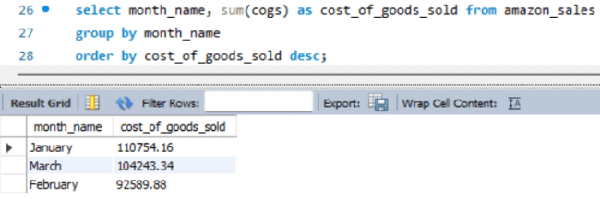
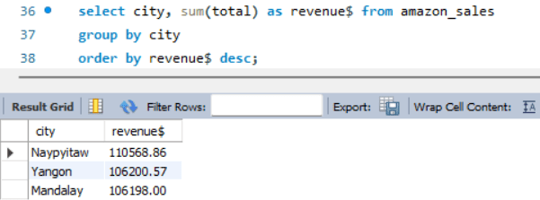
Q.8] In which month cost of goods sold reach its peak?
Q.9] Which city has the highest revenue recorded?

Slide 14
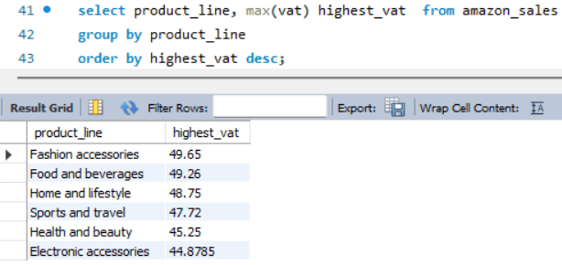
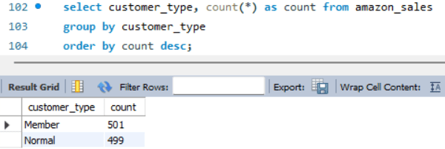
Q.10] Which product line incurred the highest value added tax?
Q.11] Which customer type occurs most frequently?

Slide 15
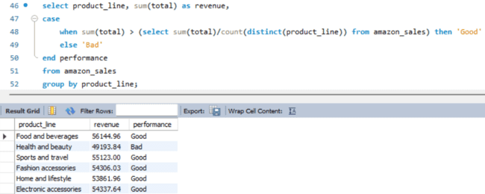
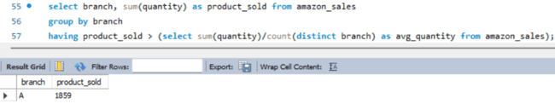
Q.12] For each product line, add a column indicating "Good" if its sales are above average, otherwise "Bad."
Q.13] Which branch exceeded the average number of product sold?

Slide 16
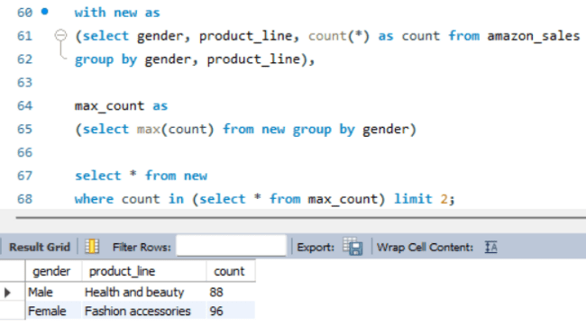

Q.14] Which product line is most frequently associated with each gender?
Q.15] What is the count of distinct customer types in the dataset?

Slide 17
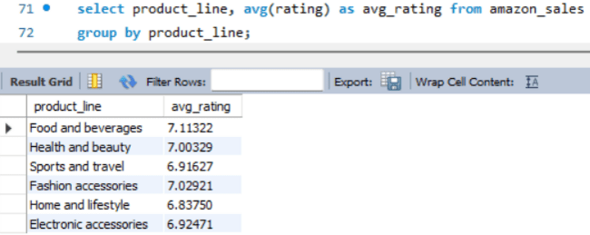
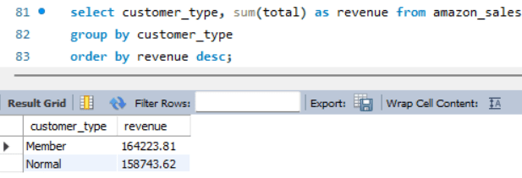
Q.16] Calculate the average rating for each product line.
Q.17] Identify the customer type contributing the highest revenue.

Slide 18
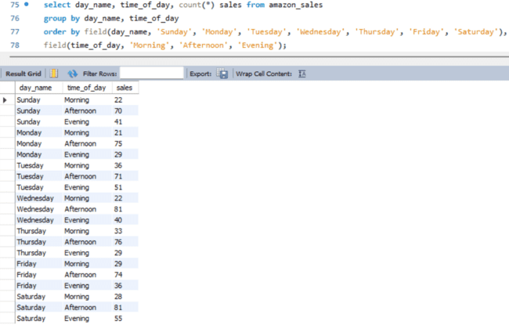
Q.18] Count the sales occurrences for each time of day on every weekday.

Slide 19
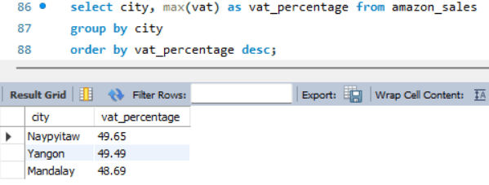
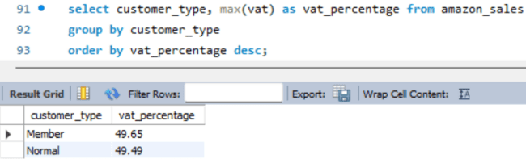
Q.19] Determine city with highest VAT percentage.
Q.20] Identify the customer type with the highest VAT payments.

Slide 20
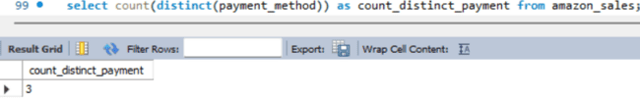
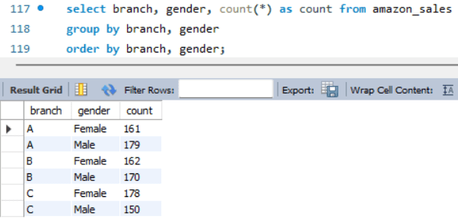
Q.21] What is the count of distinct payment methods in the dataset?
Q.22] Examine distribution of gender within each branch.

Slide 21
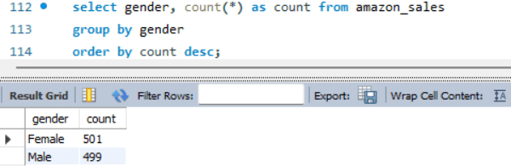
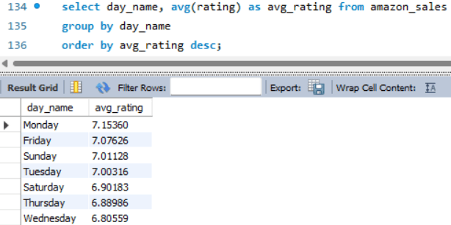
Q.23] Determine predominant gender among customer.
Q.24] Identify the day of the week with the highest average ratings.

Slide 22
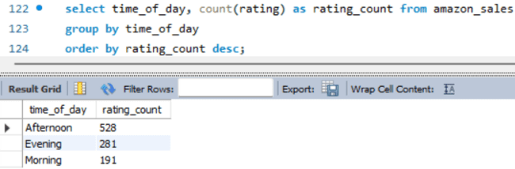
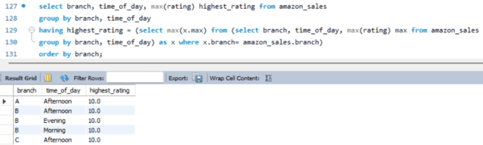
Q.25] Identify the time of day when customer provide most ratings.
Q.26] Determine the time of day with the highest customer ratings for each branch.

Slide 23
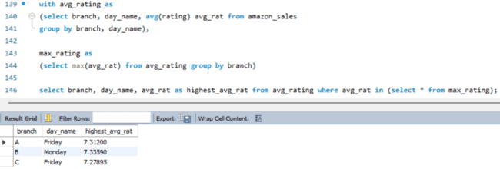
Q.27]. Determine the day of the week with the highest average ratings for each branch.

Slide 24
Key Findings
Product Analysis:
Highest Sales Product Line: Electronic Accessories (Units Sold:971)
Highest Revenue Product Line: Food and Beverages ($ 56144.96)
Lowest Sales Product Line: Health and Beauty (Unit Sold: 854)
Lowest Revenue Product Line: Health and Beauty ($ 49193.84)
Sales Analysis:
Month With Highest Revenue: January ($ 116292.11)
City & Branch With Highest Revenue: Naypyitaw[C] ($ 110568.86)
Month With Lowest Revenue: February ($ 97219.58)
City & Branch With Lowest Revenue: Mandalay[B] ($ 106198.00)
Peak Sales Time Of Day: Afternoon
Peak Sales Day Of Week: Saturday

Slide 25
Customer Analysis:
Most Predominant Gender: Female
Most Predominant Customer Type: Member
Highest Revenue Gender: Female ($ 167883.26)
Highest Revenue Customer Type: Member ($ 164223.81)
Most Popular Product Line (Male): Health and Beauty
Most Popular Product Line (Female): Fashion Accessories
Distribution Of Members Based On Gender: Male(240) Female(261)
Sales Male: 2641 units
Sales Female: 2869 units

Slide 26


